Slide 1

Exploratory Data Analysis For Boxing Matches
By: Neeraj Kumar
COHORT BATCH 2nd MARCH 2019

Slide 2
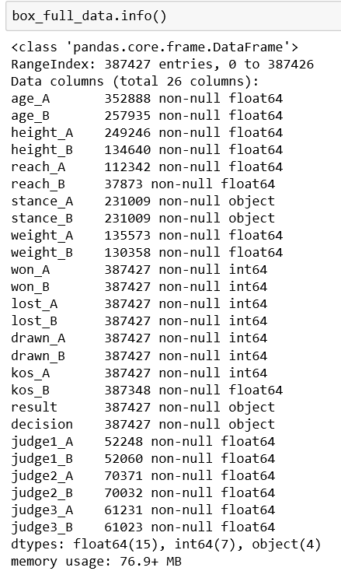
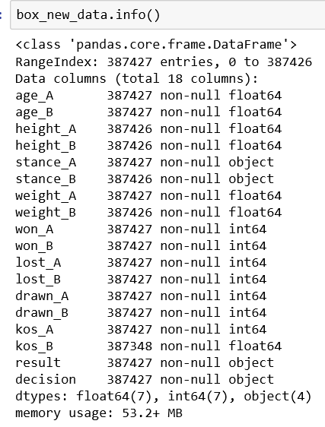
Pre- Profilling
Post- Profilling
In the Dataset info, Total Missing(%) = 20.6%
Number of variables = 26
In the Dataset info, Total Missing(%) = 0.0%
Number of variables = 18
Dropped : Judge_1,2,3__A,B columns

Slide 3
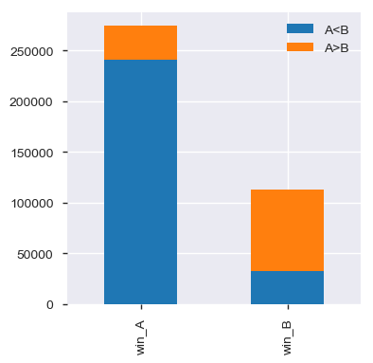
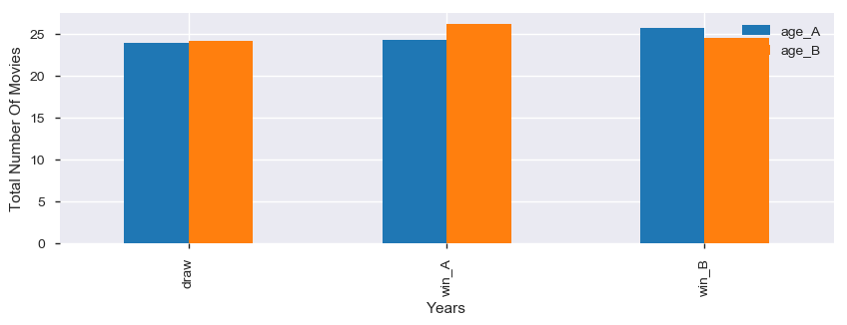
How much age of a player impacts the performace of player interms of winning ?
So based on the above plot we can clearly see that most of the times when player A is winning their age is more than player B's age and vice versa. so we can conclude that age is the determining factor in the boxing match to win.

Slide 4
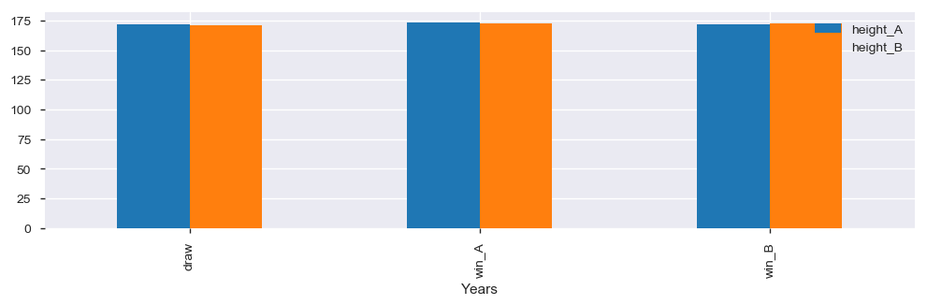
How much height of a player impacts the performace of player interms of winning ?
From the above graph plot we can see that more height has got a positive factor in winning the match

Slide 5
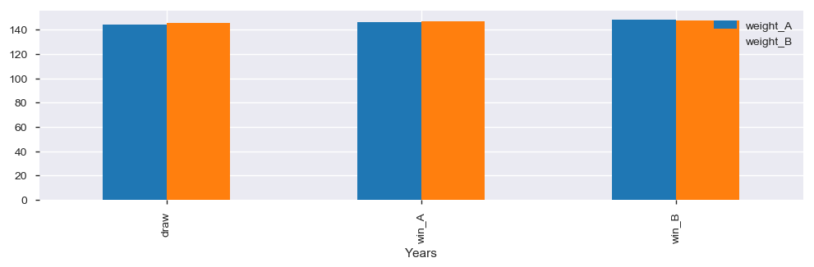
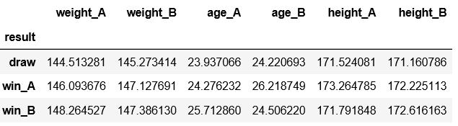
How much weight of a player impacts the performace of player interms of winning ?

Slide 6
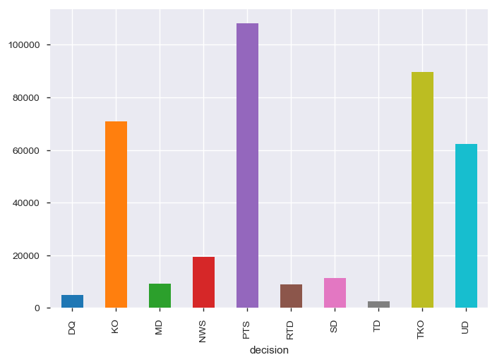
Which decisions were majorly taken in the matches?
The above plot shows the graph plot for the decions being taken while the boxing matches played

Slide 7
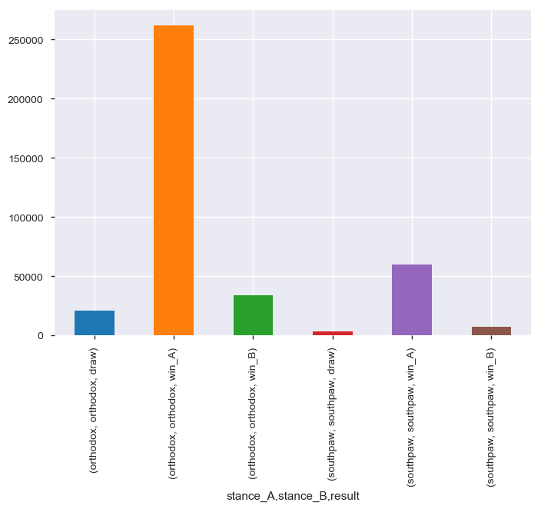
Which stances had more draw compared to other?
Probabailty of a match getting draw is more when player opt for south paw style compared to orthodox

Slide 8
Conclusion
With the help of this notebook we learnt how exploratory data analysis can be carried out using Pandas plotting.
Also we have seen making use of packages like matplotlib and seaborn to develop better insights about the data.
We have also seen how preproceesing helps in dealing with missing values and irregualities present in the data. We also learnt how to create new features which will in turn help us to better predict the survival.
We also make use of pandas profiling feature to generate an html report containing all the information of the various features present in the dataset.
We have seen the impact of columns like age,height and weight to determine winning trend of player
There could be other factors which are affecting footfall in theaters, beacuse:
1. Age, Weight and Height of player as compared with his opponent can help in guessing the winner.
2. Result of most of the matches, were decided based on POINTS DECISION.
3. Probabailty of a match getting draw is more when player opt for south paw style compared to orthodox

Slide 9
THE END

